Slide 1
Week 2 Accelerator Framework Learning Sessions [Databricks Permissions and Secret Scopes]
11.04.2021

Slide 2
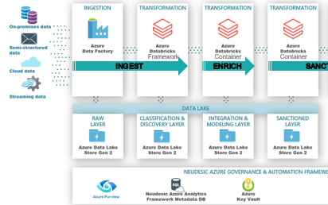
Schedule
Week 1: ADF ETL Process and adl deployments
Week 2: Data-bricks Permissions and secret scopes
Week 3: Data-bricks Framework Orchestration
Week 4: Delta Lake and Meta-Data capabilities

Slide 3
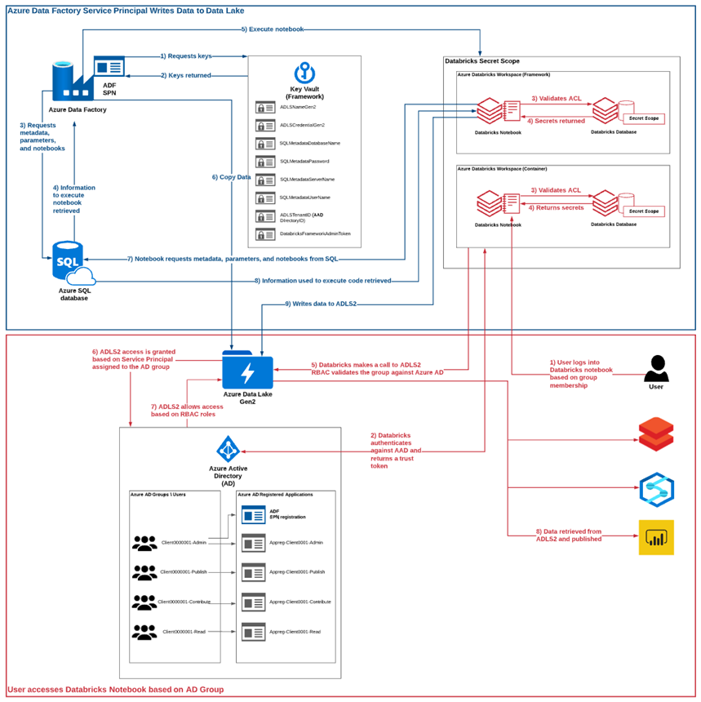
2
Cluster level permissions manages User Level Access for cilents
1
2
Databricks Secret Scopes Manages access for Data Factory
1
3
3
SCIM Connecter connects Active Directory to Databricks scopes

Slide 4
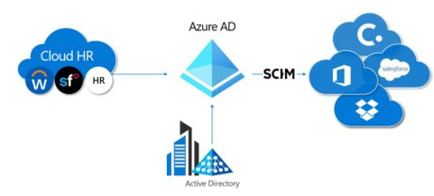

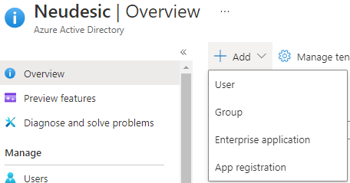
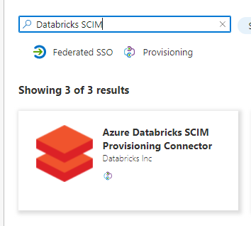
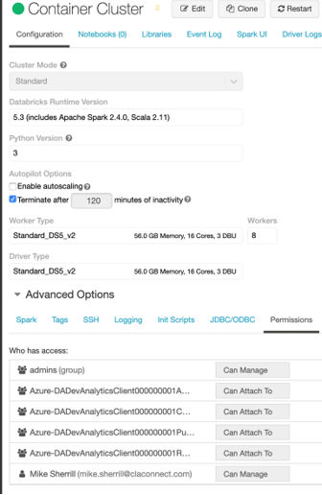
Databricks SCIM
Databricks SCIM is used to manage workplace access as per permissions in active directory
Azure Enterprise level permissions are needed for this
We don’t have access this this
Cilent IT level should have access
Successful configuration in connector should allow for cluster level permissions

Slide 5




Secret scopes
Cloud shell can be activated via icon on the top of the portal
Databricks-cli can be used to move secrets into databricks scopes via bash scripts
Secret values need to be manually entered from key vault
4 scopes are created per notebook
Container Script Link
Framework Script Link
Scopes:
framework
Key Vault:
Key Vaults Secrets
Framework
Scopes:
cilent001admin
cilent001contribute
cilent001publish
cilent001read
Active Directory Service Principals:
Service Principal IDs
Container

